Slide 1




Movie Genres Classification
Nikhil Chhadikar • Priyanka Bhamare

Slide 2
Agenda
Introduction
Dataset
Data Pre-processing
Word Embeddings
Classification Methods
Challenges
Evaluation Metrics
Key Findings

Slide 3




INTRODUCTION
Task – Prediction of movie genres based on movie overviews.
Accurate movie genre prediction enhances user experience and refines content recommendations in modern entertainment.
Classification Type - Multi-label classification
There is no constraint on how many classes can be assigned to a particular instance.
Notes:
Movie genres classification has multiple applications for online streaming services and movie hosting platforms .
It enhances user experience by helping viewers discover films aligned with their preferences.
Contributes to strategic business decisions and optimizes the effectiveness of recommendation algorithms.
Ultimately fosters viewer satisfaction and loyalty.

Slide 4
INTRODUCTION

Slide 5
Dataset
Movie Overview | Genres
 | Documentary, Short
Panoramic view of the 1901 Pan-American Exposition filmed at night. According to Edwin S. Porter, this is the first American film ever shot at night using incandescent light. | Drama, Fantasy
IMDB Movie Dataset
Size of the dataset – 41k movies
Total unique genres – 27
Average genres per movie - 3
Training data size – 70%
Dev data size – 10%
Test data size – 20%
The story of American scientist, J. Robert Oppenheimer, and his role in the development of the atomic bomb.

Slide 6
Data Pre-processing
Convert text to Lowercase
Removing Punctuations
Remove stop-words
Stemming
Tokenization
the story of american scientist, j. robert oppenheimer, and his role in the development of the atomic bomb.

Slide 7
Data Pre-processing
Convert text to Lowercase
Removing Punctuations
Remove stop-words
Stemming
Tokenization
the story of american scientist j robert oppenheimer and his role in the development of the atomic bomb

Slide 8
Data Pre-processing
Convert text to Lowercase
Removing Punctuations
Remove stop-words
Stemming
Tokenization
the story of american scientist j robert oppenheimer and his role in the development of the atomic bomb
story american scientist j robert oppenheimer role development atomic bomb

Slide 9
Data Pre-processing
story american scientist j robert oppenheimer role development atomic bomb
Convert text to Lowercase
Removing Punctuations
Remove stop-words
Stemming
Tokenization
stori american scientist j robert oppenheimer role development atomic bomb
stori american scientist j robert oppenheimer role development atomic bomb

Slide 10
Data Pre-processing
Convert text to Lowercase
Removing Punctuations
Remove stop-words
Stemming
Tokenization
stori american scientist j robert oppenheimer role development atomic bomb
['stori', 'american', 'scientist', 'j', 'robert', 'oppenheimer', 'role', 'development', 'atomic', 'bomb']

Slide 11
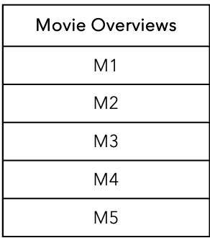

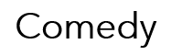
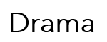


transforming the Data Labels into genre columns
Multi-Label Binarizer
Genres
Action, Comedy
Drama, Documentary
Action, Drama
Documentary, Family
Drama, Family

Slide 12
transforming the Data Labels into genre columns
Multi-Label Binarizer
Action | Comedy | Drama | Documentary | Family
1 | 1 | 0 | 0 | 0
0 | 0 | 1 | 1 | 0
1 | 0 | 1 | 0 | 0
0 | 0 | 0 | 1 | 1
0 | 0 | 1 | 0 | 1

Slide 13
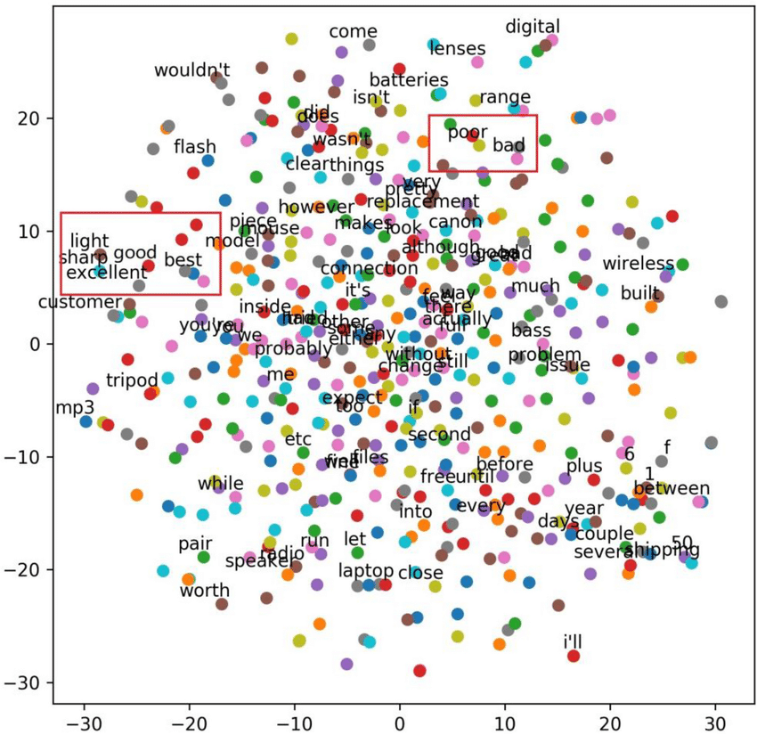
Word Embedding
Representing words as continuous numerical vectors

Slide 14
Word Embedding Methods
Bag of Words
TF-IDF
BERT Tokenizer
GloVe
Word2Vec

Slide 15
Classification Methods
Logistic Regression (Baseline)
Naïve Bayes
Random Forests
SVM
DistilBERT using BERT Tokenizer

Slide 16
Multi-Label Adaptation
Multioutput Classifier
This strategy consists of fitting one classifier per target. This is a simple strategy for extending classifiers that do not natively support multi-target classification.
Label Powerset
Transforms a multi-label problem to a multi-class problem with 1 multi-class classifier trained on all unique label combinations found in the training data.

Slide 17


Evaluation Metrics
Accuracy
Action, Thriller, War → Action, War
Action, Thriller, War → Action, Horror, War
Action, Thriller, War → Action, Thriller, War
Weighted average F1-score

Slide 18
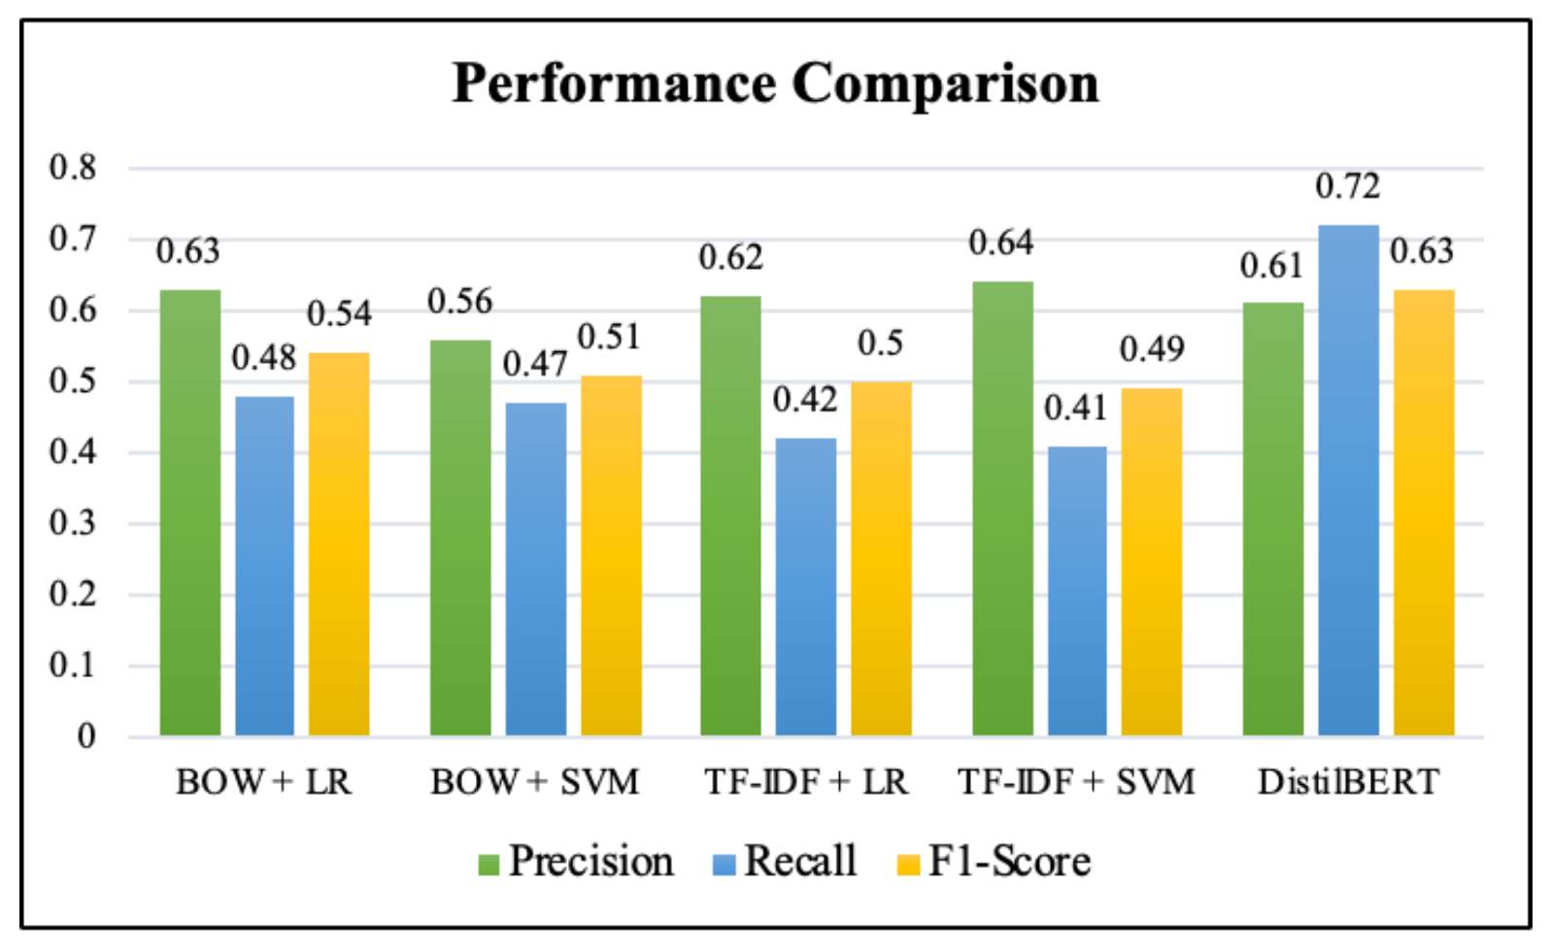
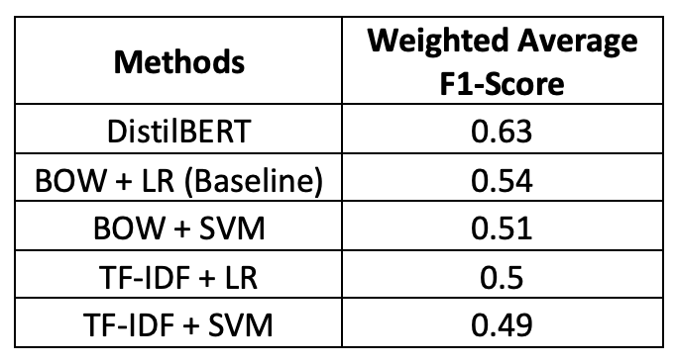
Results

Slide 19
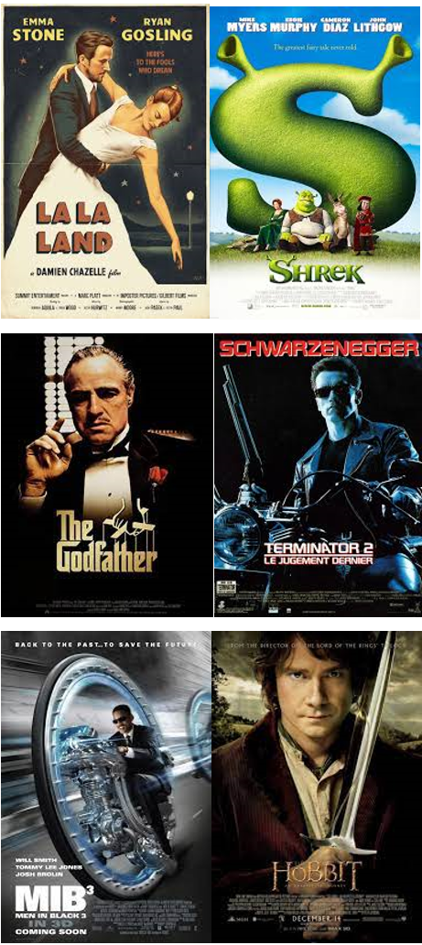
Key Findings
Issues with traditional ways
Why does DistilBERT work better?
Static word embeddings can only extract so much meaningful information from the extract.
Effect of taking label correlations into account is hard to isolate.
BERT effectively addresses word ambiguity.
Accounts for the effect of all other words in a sentence on the focus word.

Slide 20
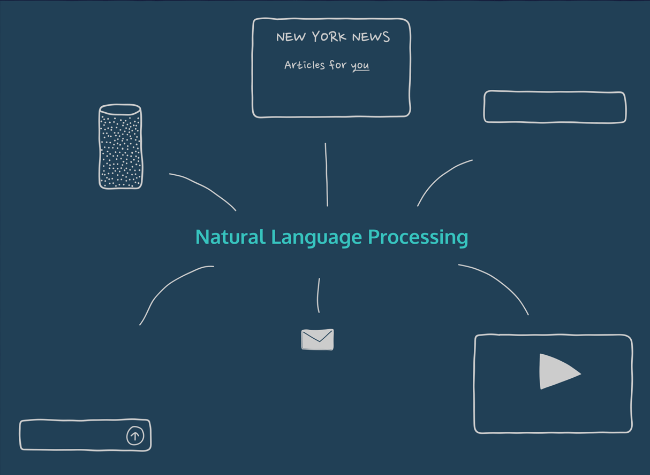
Challenges
Dataset
Classification
Data Sparsity
Imbalanced Data
Computational Complexity
Ambiguity in Labels
Feature Dimensionality
Inter-Class Variability

Slide 21
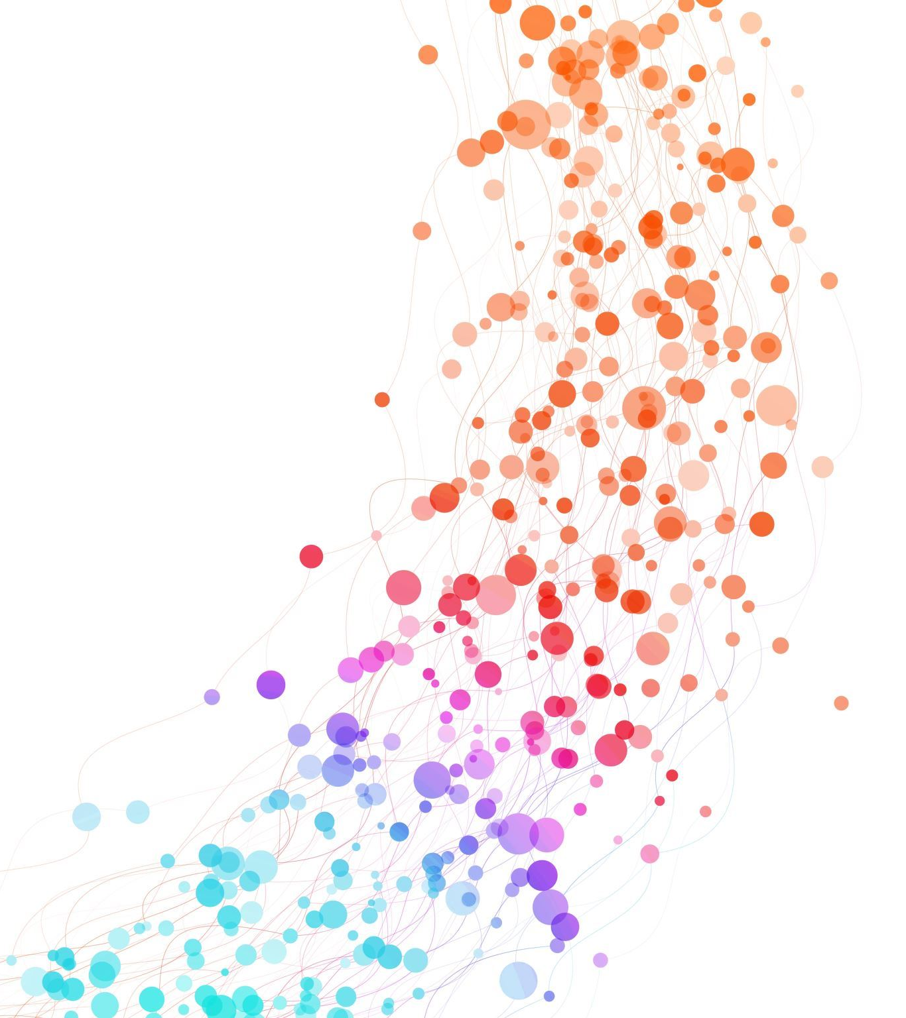
THANK YOU!
Nikhil Chhadikar
nikhil.chhadikar@unb.ca
Priyanka Bhamare
priyanka.bhamare@unb.ca

